Slide 1
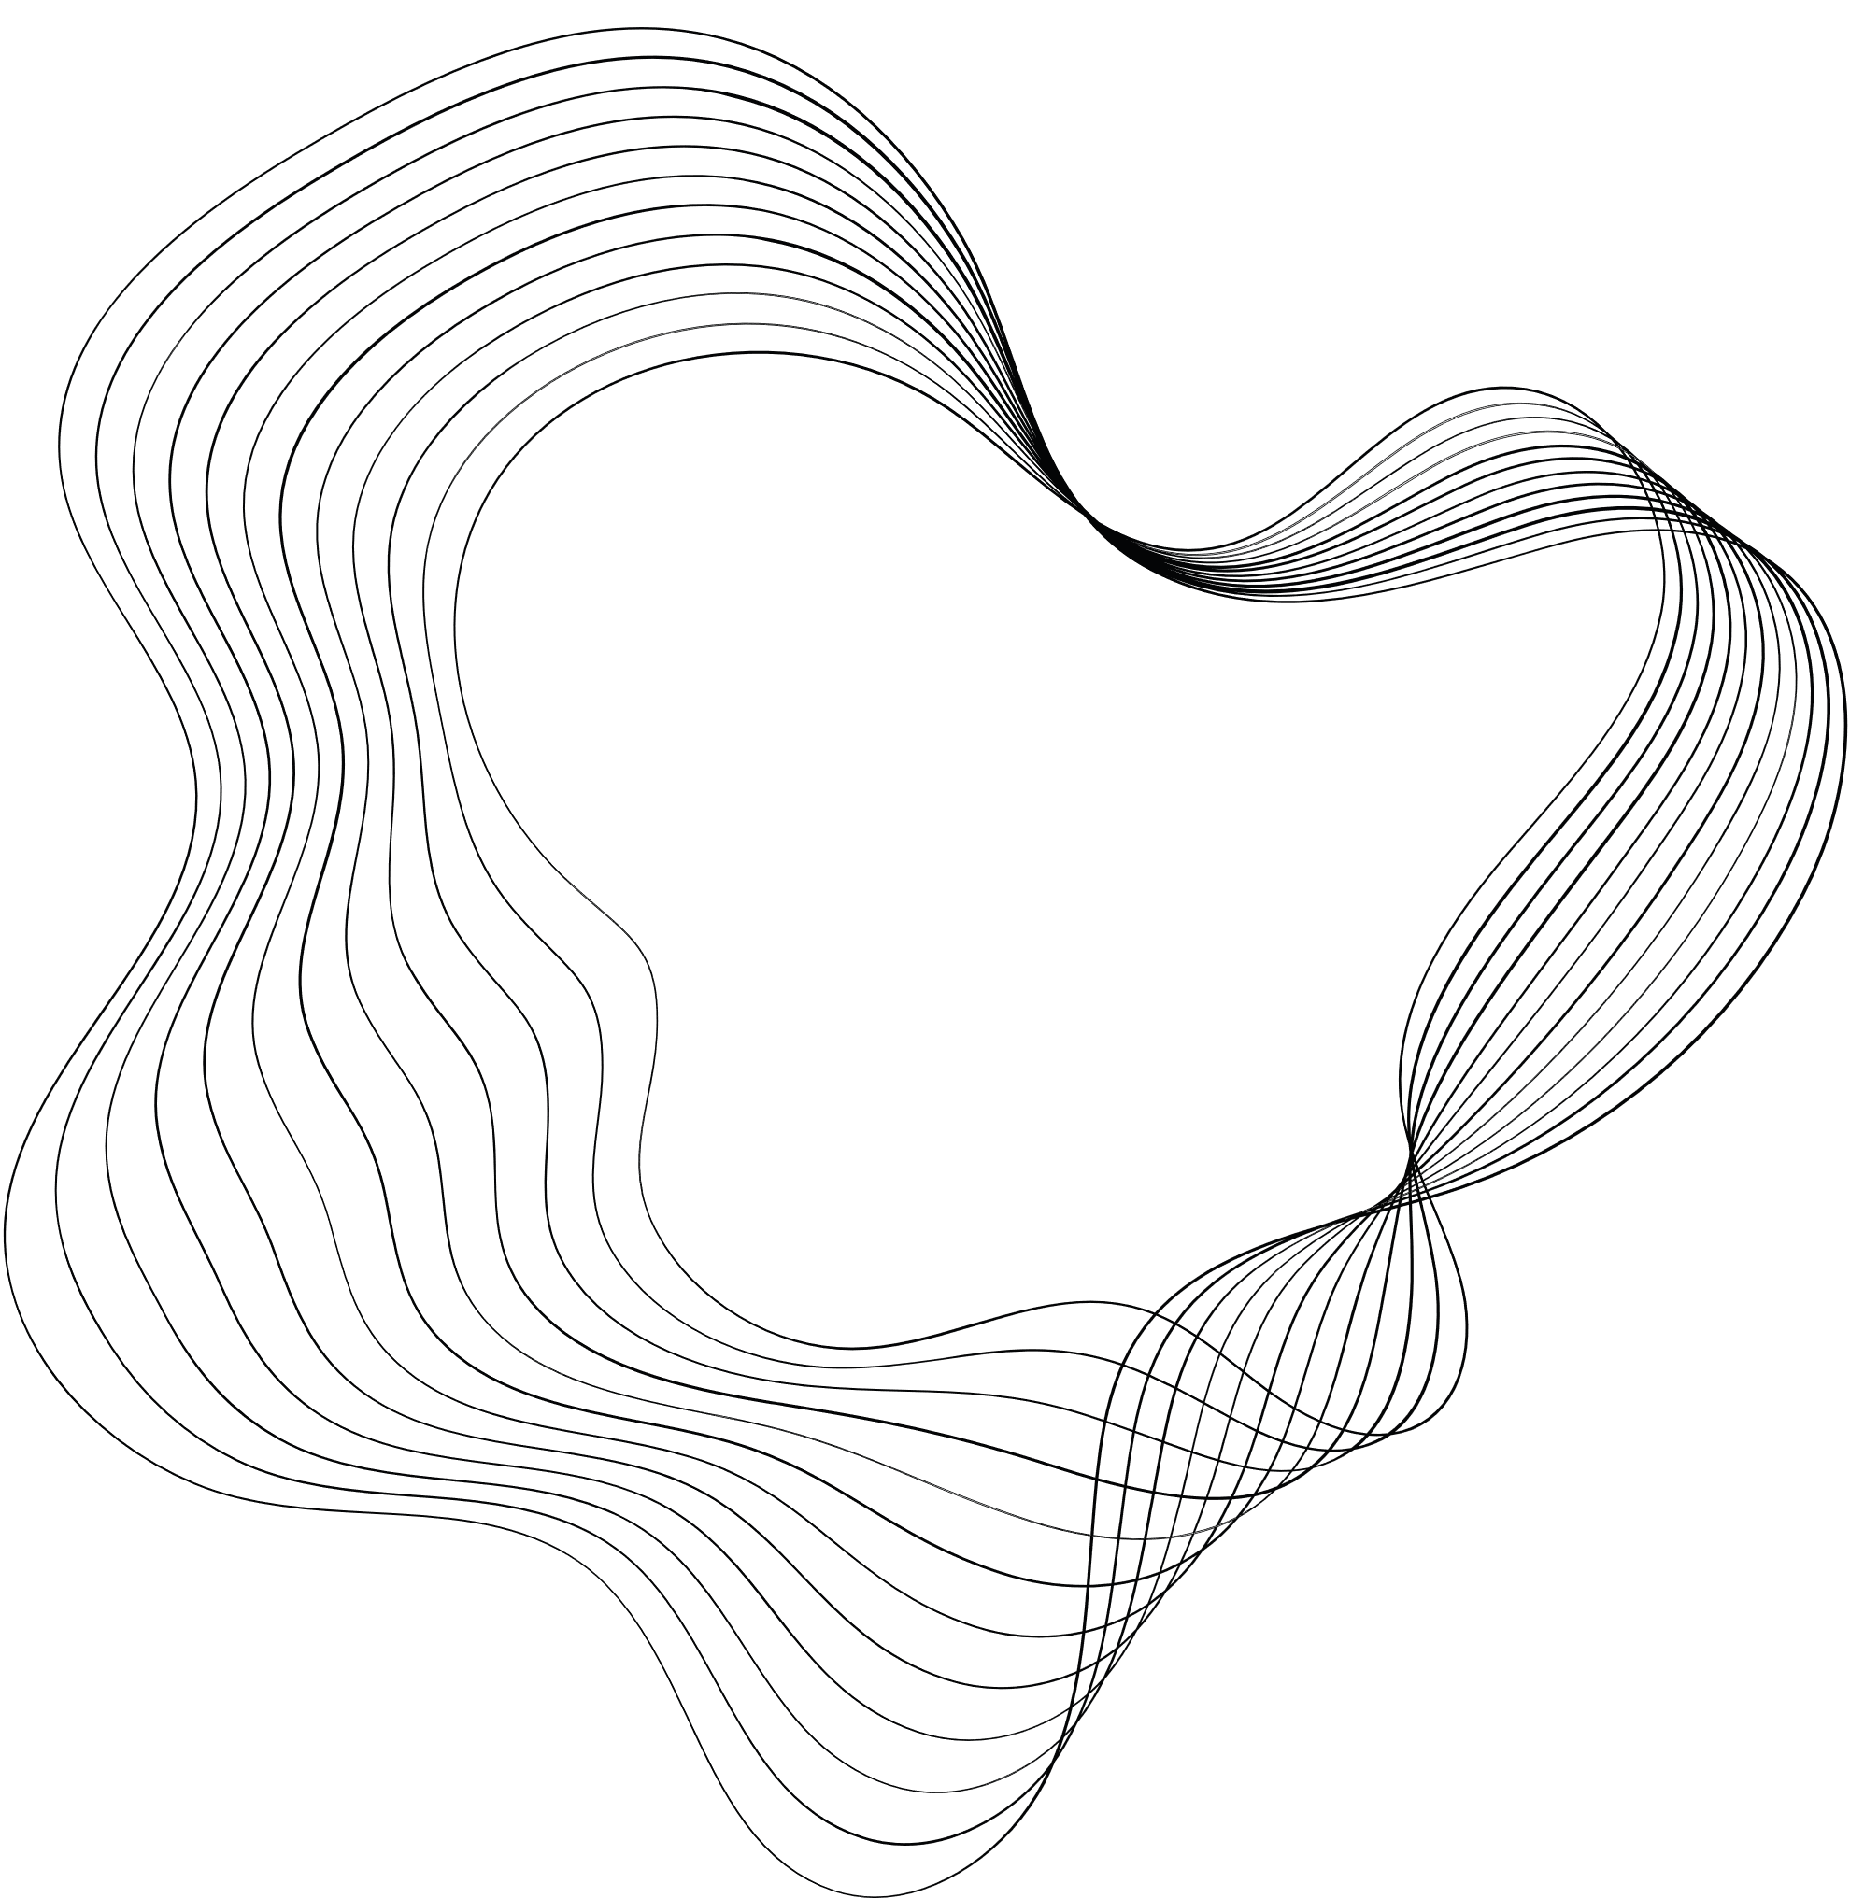

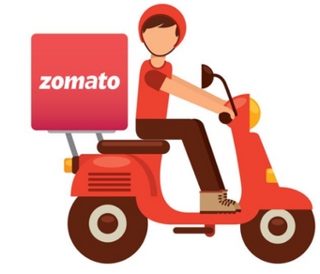
DFS/BFS ALGORITHMS IN ZOMATO
LAVANYA PAKHALE (RA2211028010132)
DEEPSHIKHA KUMARI (RA2211028010134)
SHAYAN DEY (RA2211028010135)

Slide 2

CONTENT
01
INTRODUCTION
02
IMPLEMENTATION AND VIDEO EXAMPLE
03
PSEUDOCODE
04
TIME AND SPACE COMPLEXITY

Slide 3
ALGORITHMS :
DEPTH-FIRST SEARCH (DFS)
DFS explores as far as possible along each branch before backtracking. It starts at a selected node (often called the root node) and explores as far as possible along each branch before backtracking
It uses a stack data structure to keep track of the nodes to visit.
DFS is often implemented recursively, where it explores a node's children recursively until it reaches a leaf node, then backtracks and continues the process.
BREADTH-FIRST SEARCH (BFS)
BFS EXPLORES ALL NEIGHBOR NODES AT THE PRESENT DEPTH PRIOR TO MOVING ON TO NODES AT THE NEXT DEPTH LEVEL.
It uses a queue data structure to keep track of the nodes to visit.
BFS starts at a selected node (often called the root node) and explores all of its neighbors at the present depth level before moving on to the nodes at the next depth level.

Slide 4
IMPLEMENTATION IN ZOMATO (MENU BROWSING)
These traversal algorithms can be used to navigate through the hierarchical tree structure of menus. They enable efficient exploration of menu categories and subcategories, ensuring that users can easily browse through the menu options.
DFS Implementation:
The user selects the "Pasta" category from the menu.
Zomato employs the Depth-First Search (DFS) algorithm to explore the "Pasta" category deeply. The DFS algorithm starts by presenting various types of pasta dishes within the selected category.
Within the "Pasta" category, the DFS algorithm explores each subcategory or individual pasta type. For example, it might present options like "Spaghetti," "Fettuccine," "Penne," and so on.
DFS continues its exploration recursively, presenting all available pasta dishes within the selected category before moving on to related subcategories or menu items.
User Experience: The user experiences a deep dive into the "Pasta" category, viewing a comprehensive list of pasta dishes without necessarily seeing items from other categories until the entire "Pasta" category is explored.

Slide 5


Slide 6
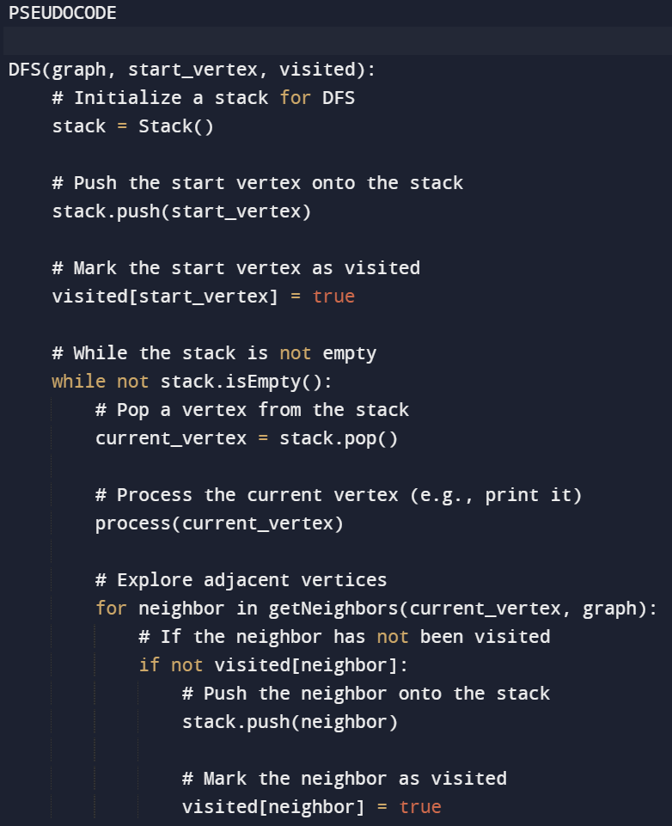
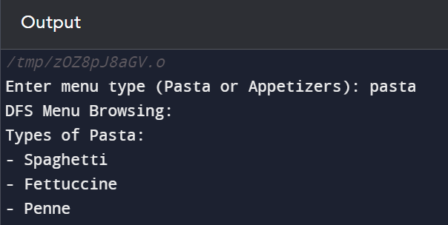

Slide 7
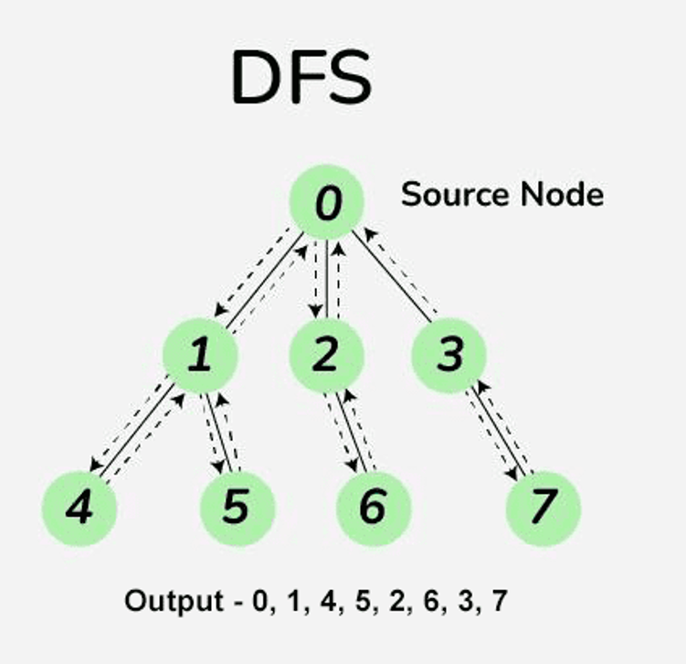
This is how backtracking and traversal works

Slide 8
BFS Implementation
Another user selects the "Appetizers" category from the menu.
Zomato utilizes the Breadth-First Search (BFS) algorithm to systematically display all available appetizers. Unlike DFS, BFS moves horizontally across categories before delving deeper.
In the "Appetizers" category, Zomato starts by presenting all immediate subcategories or individual appetizer items. For example, it might show "Bruschetta," "Mozzarella Sticks," and "Chicken Wings."
After presenting the initial set of items within the "Appetizers" category, BFS systematically moves to other related categories, presenting items from each category one level at a time.
The user experiences a systematic exploration of the "Appetizers" category and related categories, allowing them to view a variety of appetizers before moving on to other sections of the menu.

Slide 9


Slide 10
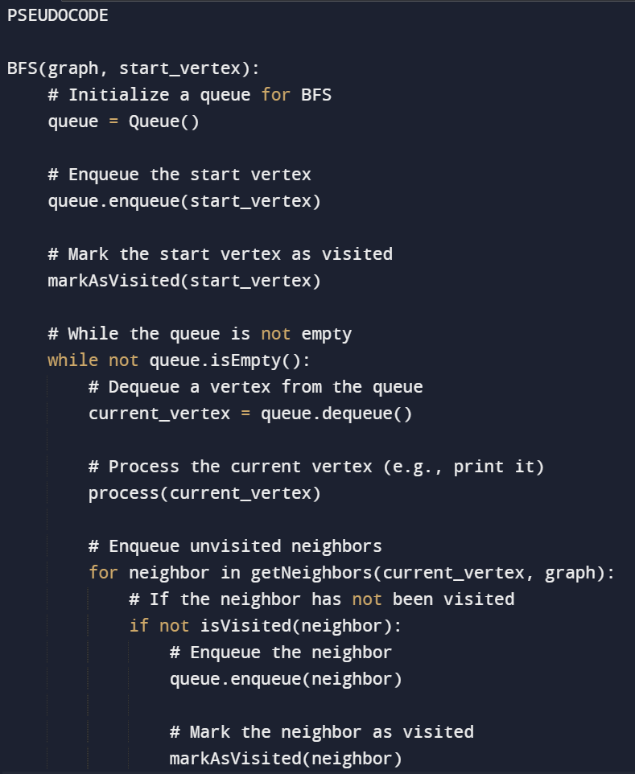
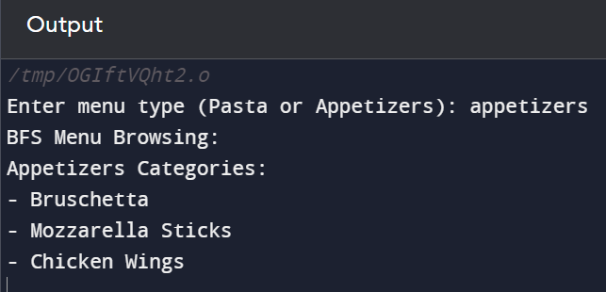

Slide 11
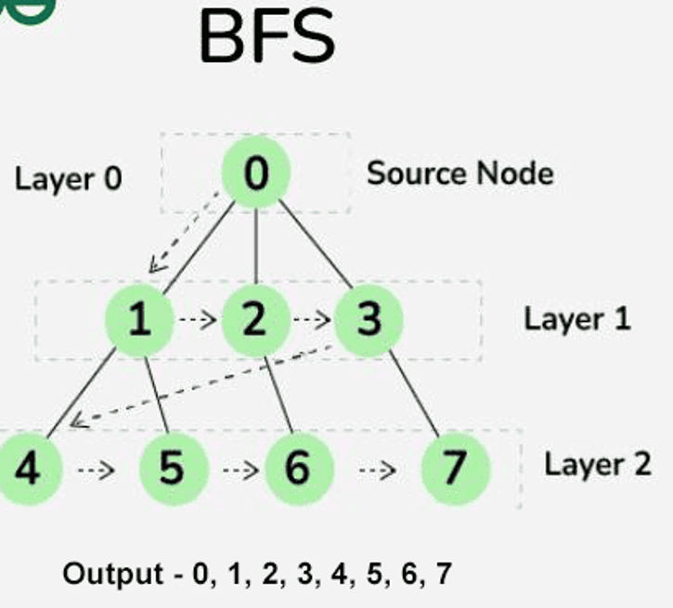
This is how level-order traversal works

Slide 12
TIME AND SPACE COMPLEXITY IN DFS
DFS:
Time Complexity: O(V + E), where V is the number of menu items (vertices) and E is the number of connections between items.
In the context of menu browsing, each menu item can be considered a vertex, and the connections between items represent relationships such as subcategories or similar items.
The DFS algorithm traverses through each menu item and explores its connections. It continues this process until all items have been visited, which contributes to the time complexity.
Space Complexity: O(V) for the stack used in recursive DFS.
In a recursive implementation of DFS, a stack is used to keep track of the nodes to visit. As the DFS algorithm progresses deeper into the menu hierarchy, nodes are pushed onto the stack, potentially leading to a space complexity proportional to the number of menu items (vertices) in the worst case.

Slide 13
DFS (Depth-First Search):
Best Case:
The best-case scenario occurs when the desired item is located near the root of the menu hierarchy. In this case, DFS may find the item quickly, resulting in a time complexity of O(1) or close to constant time.
Worst Case:
The worst-case scenario happens when the desired item is located deep down in the menu hierarchy or when the menu structure is heavily branched. In such cases, DFS may traverse the entire depth of the menu, resulting in a time complexity of O(D), where D is the depth of the menu.
Average Case:
The average-case time complexity of DFS is often difficult to determine precisely, as it depends on the specific characteristics of the menu structure and user browsing patterns. However, in many practical scenarios, DFS tends to be efficient in finding items due to its deep exploration nature.

Slide 14
TIME AND SPACE COMPLEXITY IN BFS
BFS:
Time Complexity: O(V + E)
Similar to DFS, the time complexity of BFS in this context is O(V + E), where V is the number of menu items (vertices) and E is the number of connections between items.
BFS explores each menu item and its connections level by level, ensuring that items at the same level are visited before moving to the next level.
Space Complexity: O(V) for the queue used in BFS.
In BFS, a queue data structure is used to keep track of the nodes to visit. As the algorithm progresses, nodes are enqueued and dequeued from the queue. The space complexity of BFS is therefore proportional to the number of menu items (vertices), as the queue may hold all vertices at a particular level before moving to the next level.

Slide 15
BFS (Breadth-First Search):
Best Case:
Similar to DFS, the best-case scenario for BFS occurs when the desired item is located near the root of the menu hierarchy. BFS starts by exploring the immediate neighbors, so in the best case, it can find the item quickly with a time complexity of O(1) or close to constant time.
Worst Case:
The worst-case scenario for BFS is when the desired item is located at the last level of the menu hierarchy, and BFS needs to traverse through all levels. In such cases, the time complexity is O(N), where N is the total number of items in the menu.
Average Case:
Similar to DFS, determining the average-case time complexity of BFS depends on the specific menu structure and user behavior. On average, BFS tends to be more consistent in terms of time complexity compared to DFS, as it systematically explores levels of the menu.

Slide 16
ROLES OF TEAMMATES:
LAVANYA PAKHALE – BFS study and analysis
(RA2211028010132)
DEEPSHIKHA KUMARI – DFS study and analysis
(RA2211028010134)
SHAYAN DEY – Time and Space Complexity analysis
(RA2211028010135)

Slide 17
Thank
you!

